Slide 1
AguaClara LEED Design
Team RC
CongCong Wu
Roswell Lo

Slide 2

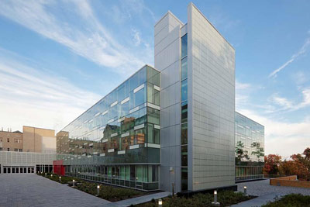
What is LEED?
Leadership in Energy and Environmental design
Most widely used green building rating system in the world
LEED certification is a globally recognized symbol of sustainability achievement *
Cornell’s Human Ecology Building achieved LEED platinum in 2011
Notes:
Provides a framework to create healthy, highly efficient and cost- saving green buildings
LEED is about marketing and PR. No intrinsic value but Being LEED certified may raise value of building, low long term energy costs.

Slide 3

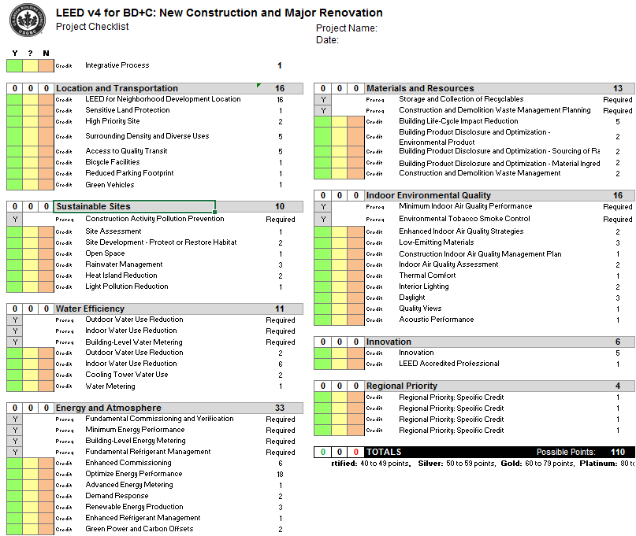
How does LEED work
A project must earn a minimum amount of points to achieve certification
Certified: 40-49 points
Silver: 50-59 points
Gold: 60-79 points
Platinum: 80+ points
Out of a total of 110 possible points

Slide 4
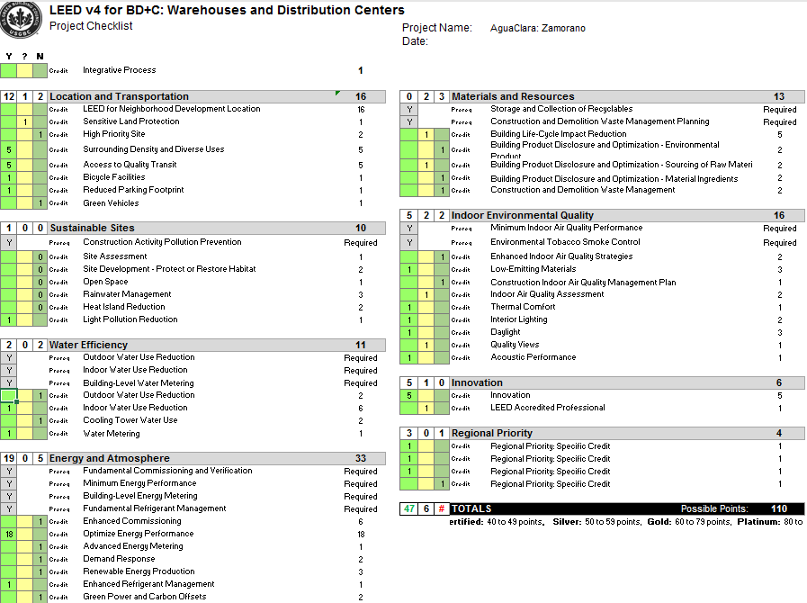
Our LEED Scorecard
Notes:
Based off our own evaluations (NOT LEED accredited)
- Optimistic grading of 47 points. Enough to be LEED certified.

Slide 5
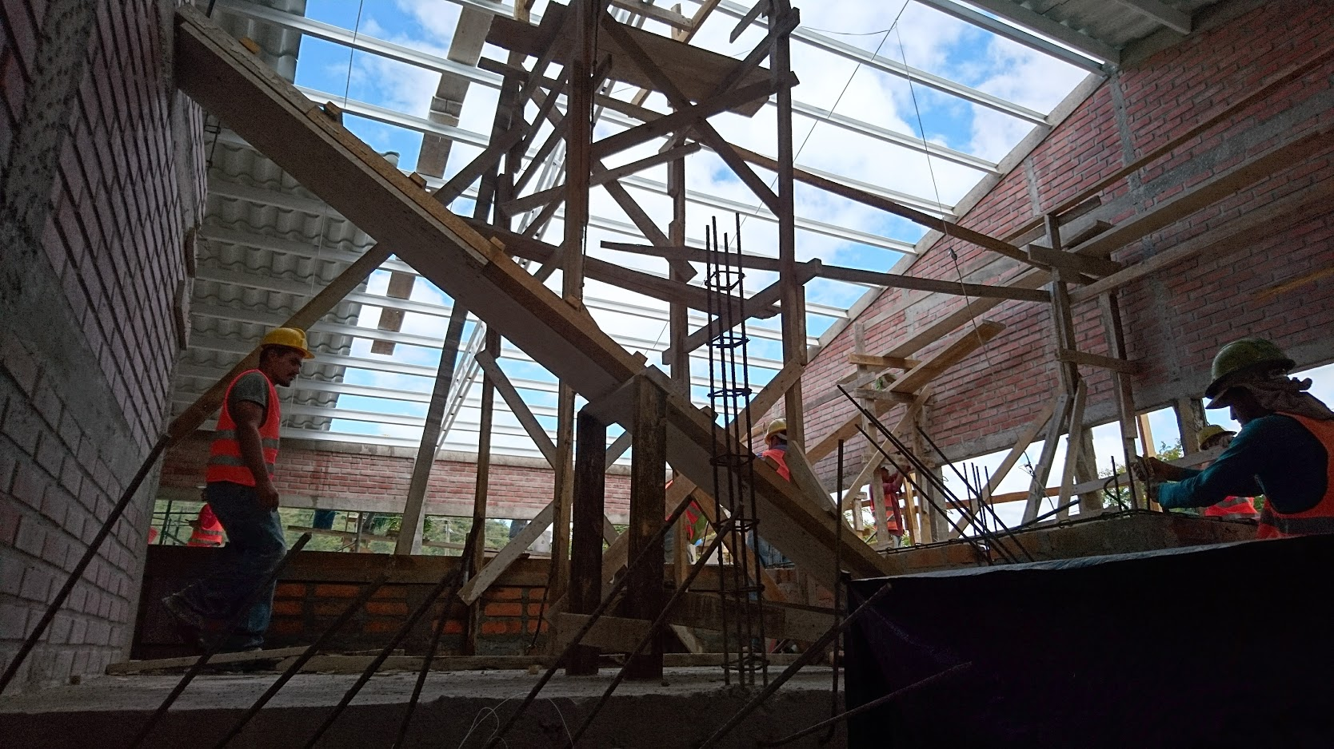
Is LEED a good fit for AguaClara?
Registration and review fees typically total under $10,000
Fees for architectural and engineering firms
Adds about ~1% construction cost to project
Zamorano Plant Currently Under Construction
Notes:
From : Matthew Kozlowski – LEED AP Cornell University- Facilities Enginering
- Coordinating LEED project submittal often hired to outside firms
Usually hired out to outside firms
Adds about ~1% construction cost to project (DOES NOT SCALE WITH SIZE). Cornell university projects usually exceed $5M in value.
- A smaller/less expensive project can often be more complex to document than a larger higher dollar value project with less of an opportunity to absorb cost.
We would be better off investing into another PLANT!

Slide 6
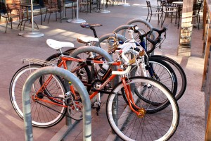
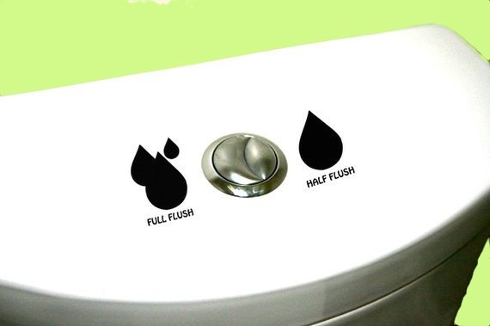
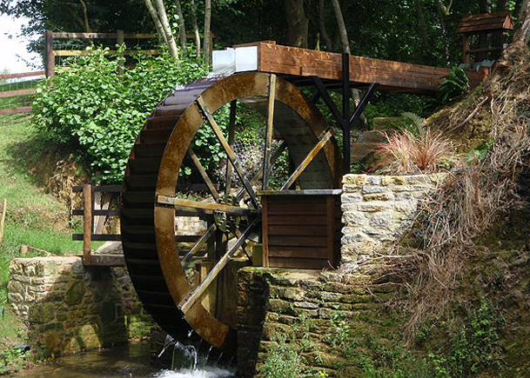
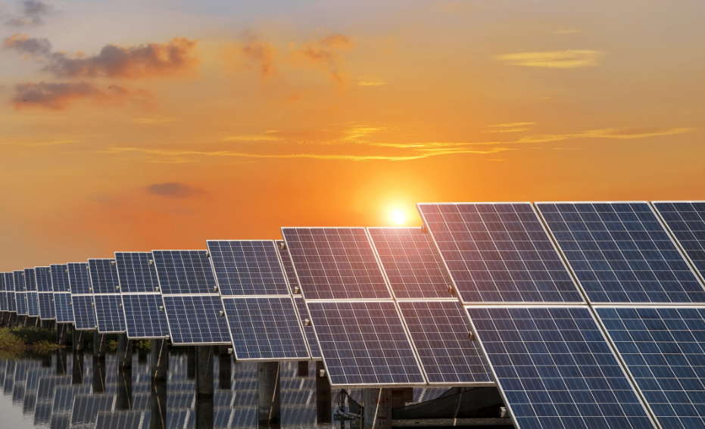
Recommendations Based on LEED
Bicycle Facilities
Include Bike rack
Indoor water Use Reduction
Dual Flush toilet
Energy efficient sinks
Renewable energy production
Hydroelectric Power (MicroHydro)
Carbon Offsets
Materials and Resources
Ensure use and proper management of efficient materials during construction

Slide 7
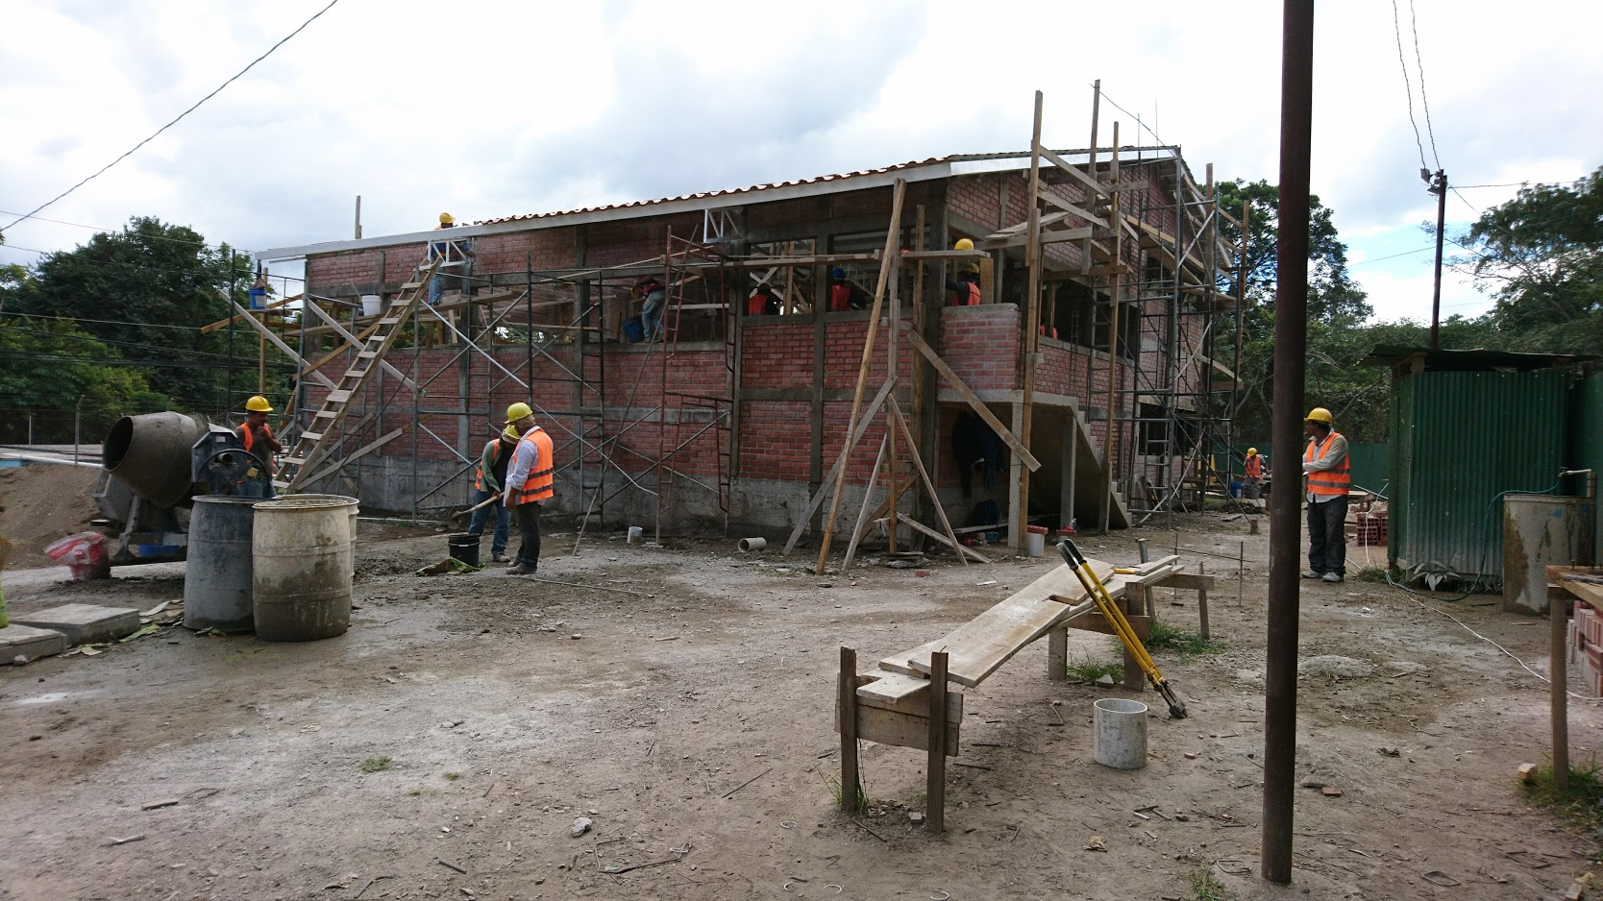
Recommendations Based on LEED
Indoor air quality
Storage of Chlorine
Thermal Comfort
Fan cooling System
Daylight
Bad for water plant
Good for people
Zamorano Plant Currently Under Construction
Notes:
Affect indoor air quality, and corrodes pipes
Stock tanks on balcony currently , should be stored in separate room
Thermal comfort- NO AC system currently planned.
Daylight
Windows, but current plan is to put blinds to block sunlight (bad for plant)
Have areas with sunlight (office, and places not affecting plant)

Slide 8
AguaClara Economic Model based on LEED’s?
LEED certifies buildings,
Charges $$
Building gets LEED certification, becomes more valuable
LEED spends $ on marketing
AguaClara makes Hydraulic Plant Designs
Agua Para el Pueblo uses designs to build plants
Charge to make plants AguaClaraTM certified??

Slide 9
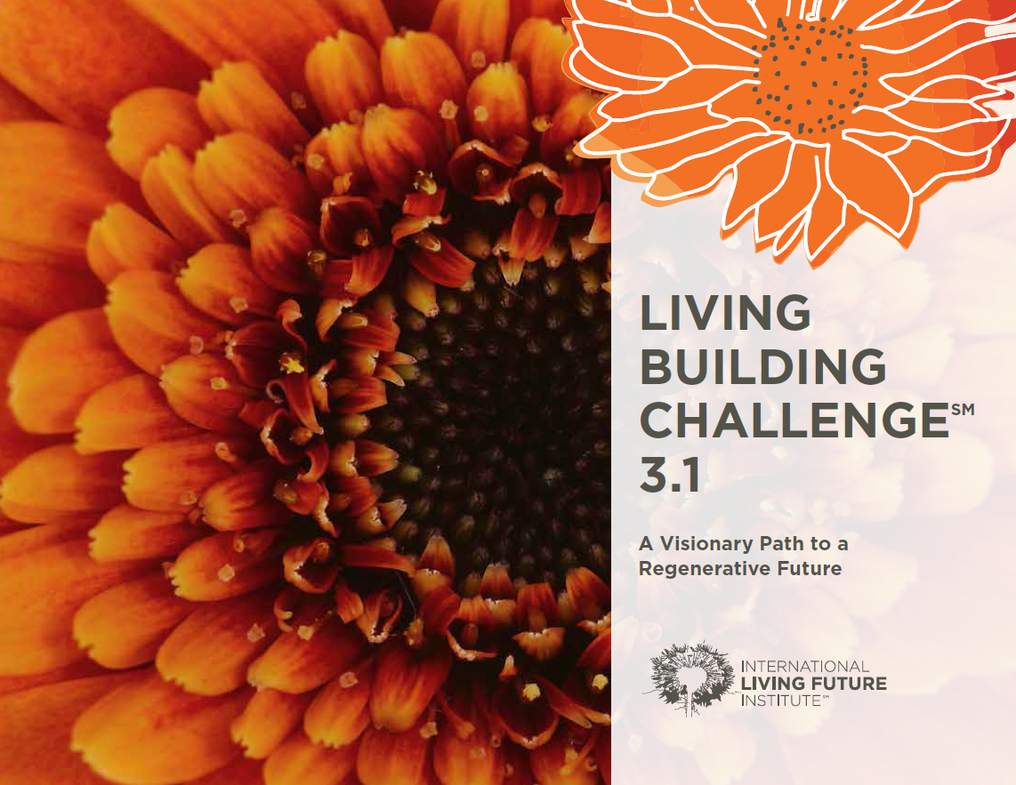
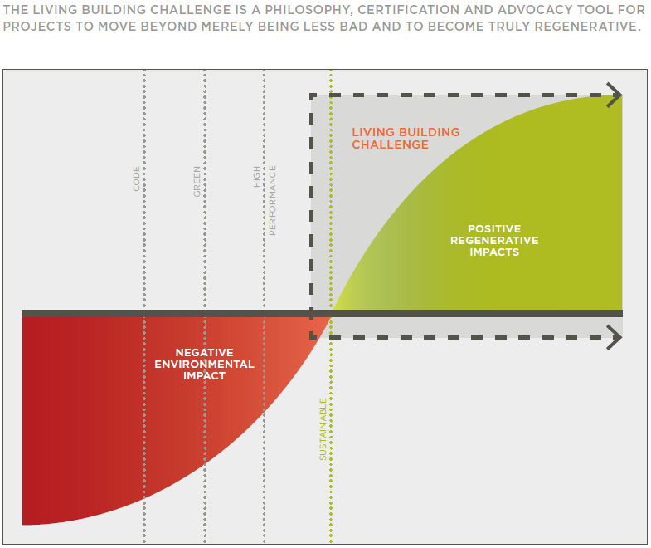
Other Options?

Slide 10
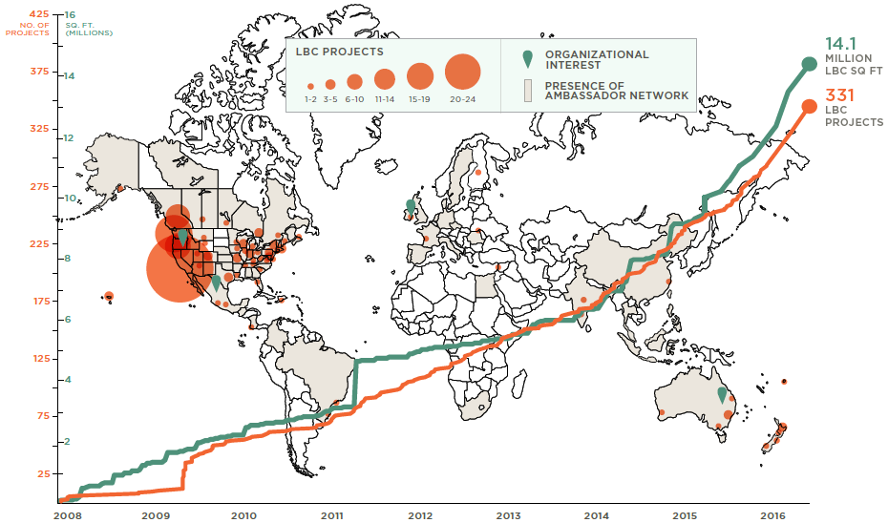

Slide 11
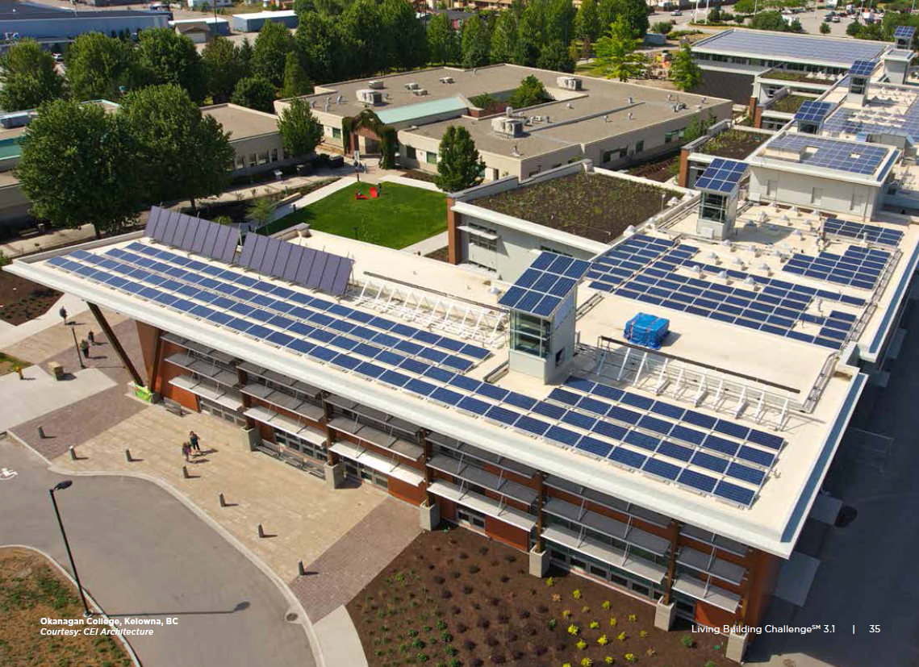
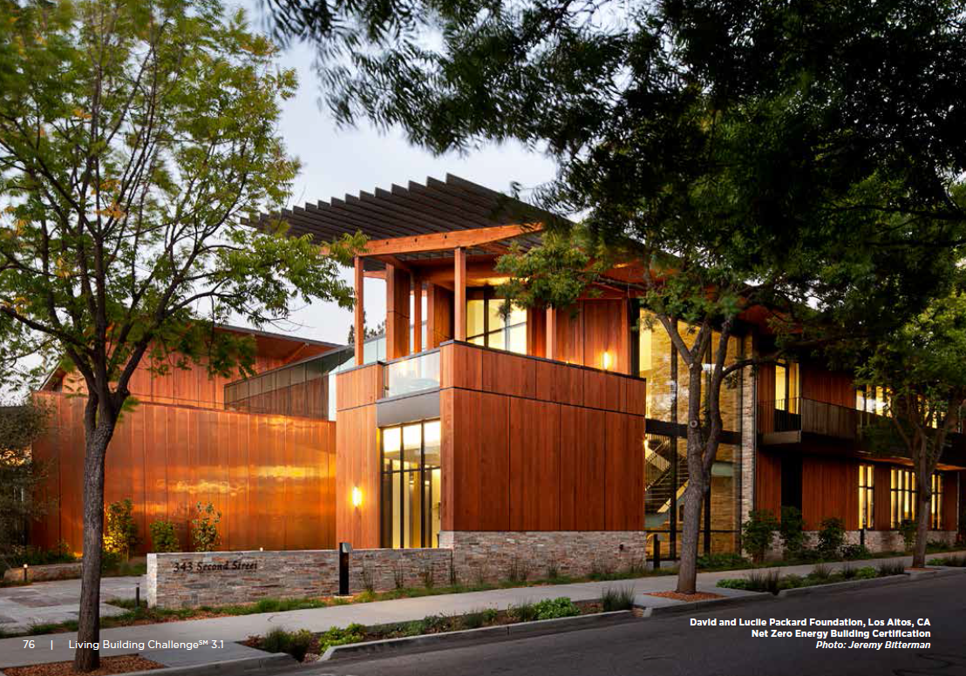
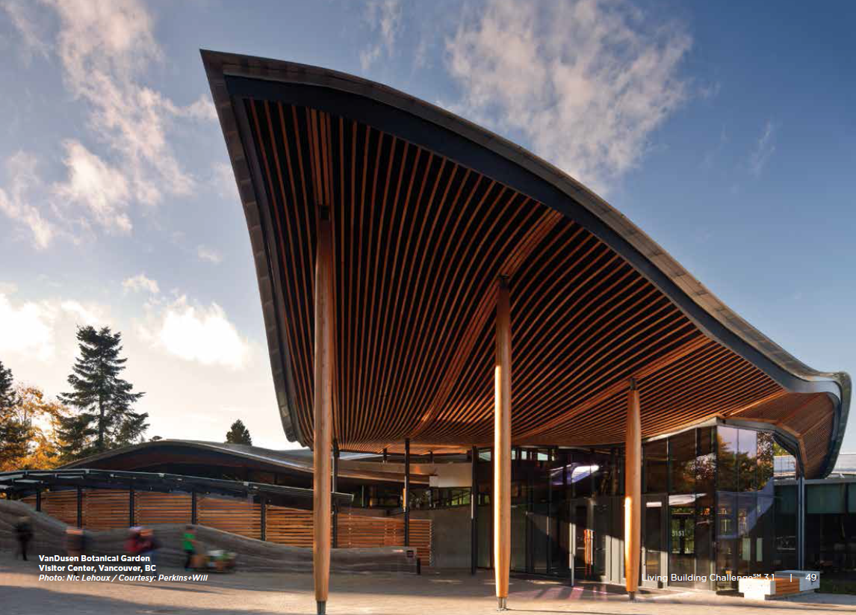
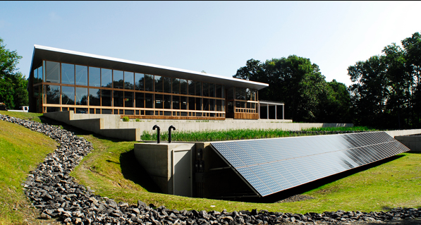
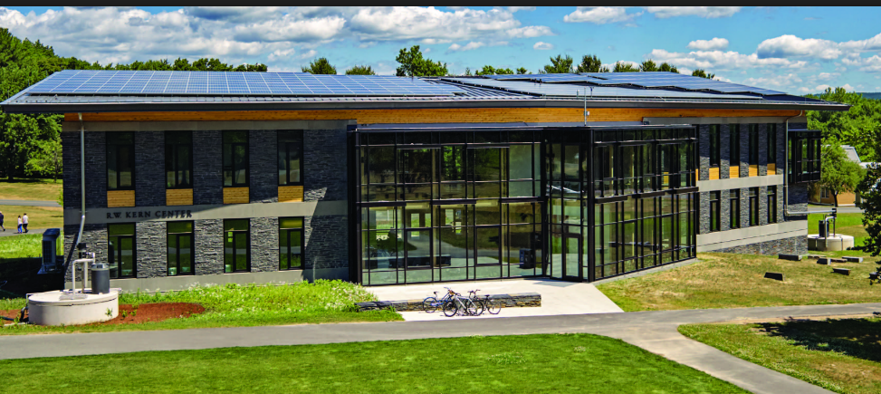
Questions/ Comments?
Notes:
Bottom Left : Omega Institute (wasterwater treatment plant in NY)
Bottom right: BD+C university

Slide 12
Citations
https://new.usgbc.org/leed
https://living-future.org/lbc/

